Slide 1

How Will NY Achieve Its Climate Act Targets?
A Look at the Draft Scoping Plan
New Yorkers for Affordable Energy
Donna L. DeCarolis
Feb. 16, 2022

Slide 2
Achieving a Low-Carbon Future in New York State
Our View…
We Need a Balance...
CLCPA Goals and Objectives
Consumer Impacts
70% Renewable Energy
by 2030
Safety and Reliability
100% Zero-emission Electricity
by 2040
Resiliency and Delivery Security
85% GHG Reduction by 2050
Energy Affordability
“All-of-the-above” Carbon Reduction Approach
2

Slide 3
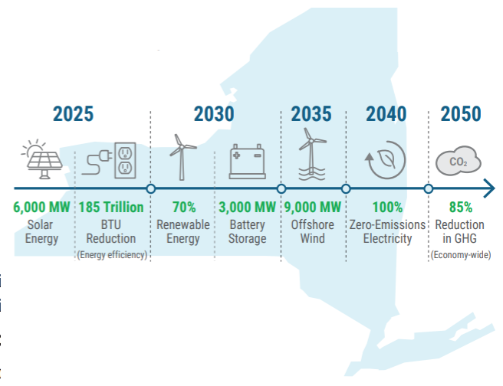




What’s IN the Draft Scoping Plan?
A Number of Statewide Prohibitions
  No new gas service to existing buildings, beginning in 2024
  No natural gas within newly constructed buildings, beginning in 2024
  No new natural gas appliances for home heating, cooking, water heating, and clothes drying beginning in 2030
  No gasoline-automobile sales beginning in 2035
The Plan will have a significant impact on New York residences and businesses, including elimination of energy choice and a likely increase in overall energy costs.
3

Slide 4
What’s IN the Plan?
Gas System Transition Recommendations
Natural gas system must be downsized to decarbonize; decommission (moth-ball) the natural gas system across NYS.
With a focus on near-full electrification, the majority of current natural gas customers will transition to electricity by 2050.
NYS should not impose undue cost burdens, especially to those who can least afford cost increases.
Incentives/rebates for gas equipment should be ended immediately.
NYS would update its building codes to limit the use of natural gas and other fossil fuels in new construction.
Final scoping plan will include a framework to develop a coordinated plan for the orderly downsizing of the gas system (plan development to be led by DPS).
4

Slide 5
Gas System Transition Recommendations
What’s NOT in the Plan?
An ‘all of the above’ approach for decarbonization utilizing both natural gas and electric systems to achieve emissions reductions more affordably and reliably through…
  Widespread energy efficiency emphasizing building envelope.
  Hybrid dual-fuel heating and cooling.
  Leveraging the natural gas delivery system incorporating low and no-carbon fuels.
    Renewable natural gas
    Green Hydrogen
    Decarbonizes natural gas network in near-term
5

Slide 6

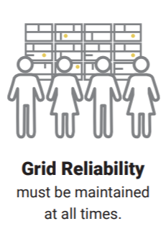



What’s MISSING from the Draft Scoping Plan
Full Assurance of Ongoing Energy Reliability
Existing “electric-based clean energy technologies” can’t meet forecasted demand & maintain reliability
Unprecedented level of NEW renewable energy generation development in next 8 years. 26% current 70% required
NYISO published its concern about declining levels of reliability beginning as early as 2023
Measures will likely increase consumer cost for potentially less reliability
6

Slide 7
What’s MISSING from the Draft Scoping Plan
Full Assessment of Affordability
WNY Manufacturers
Converting a natural gas home in upstate NY to all electricity:
  $20,000 - $50,000 Presentation to the CAC
  $35,000 - Consumer Energy Alliance Analysis
  $40,000-$50,000 Internal analysis for an older WNY Home
Based on the average customer data for our 46 largest users
7

Slide 8
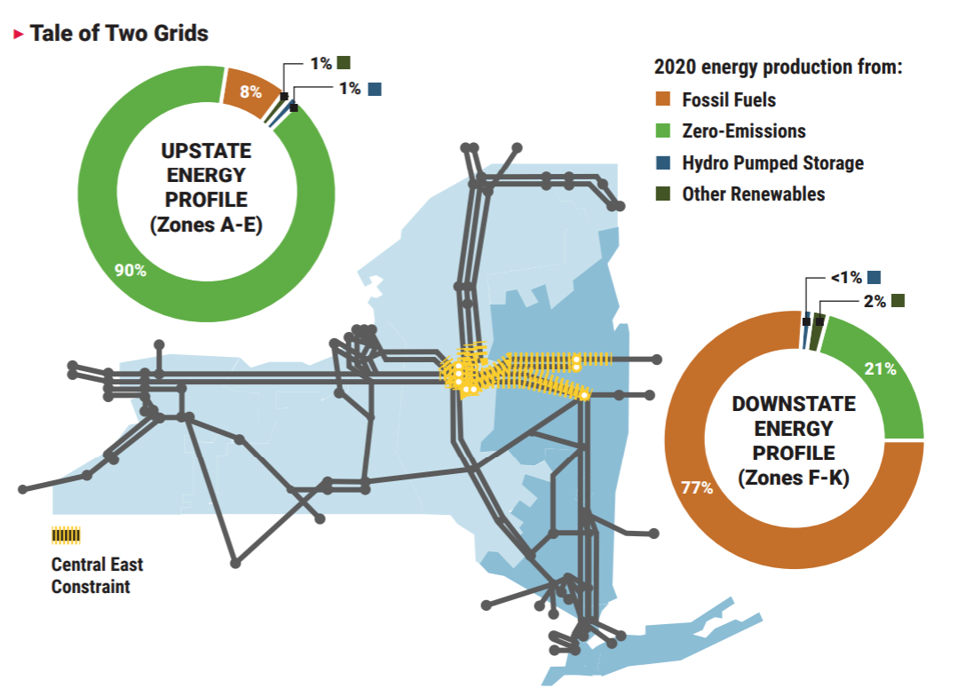
What’s MISSING from the Draft Scoping Plan
Allowing Regional Solutions For Regional Differences
Upstate vs. Downstate Differences
  Plan will be more burdensome for WNYers
    Weather is 56% colder
    94% of energy used on the coldest WNY winter day is natural gas
    Older, larger Upstate housing stock
    Burden falls hardest on Upstate residents - Downstate produces more emissions
These impacts and costs resulting from the Plan’s proposals have not been adequately analyzed and are not disclosed in the Plan.
8

Slide 9
An All-of-the-Above Pathway
What Do We Propose?
Through three key building blocks:
  Widespread energy efficiency that emphasizes weatherization
  Dual-energy heating and cooling systems
  Use of the existing natural gas infrastructure to incorporate low carbon fuels
This will yield a 93% emissions reduction for our region.
We will reach the State’s goals in less burdensome way for consumers.
9

Slide 10
Pathways to a Low-Carbon Future
National Fuel Believes:
Essential to leverage use of existing gas transmission and delivery infrastructure
  Highly reliable and resilient.
  Underground, storm-resistant and largely paid for by consumers.
  Can decarbonize faster and more affordably than grid build-out for high-electrification scenario.
  Provides for multiple sources of energy and storage, and multiple delivery options for homes and businesses.
  Ready to blend low carbon and no-carbon fuels (RNG/Green Hydrogen).
  99.99% reliability on natural gas delivery.
National Fuel’s “Pathway to a Low-Carbon Future”
10

Slide 11
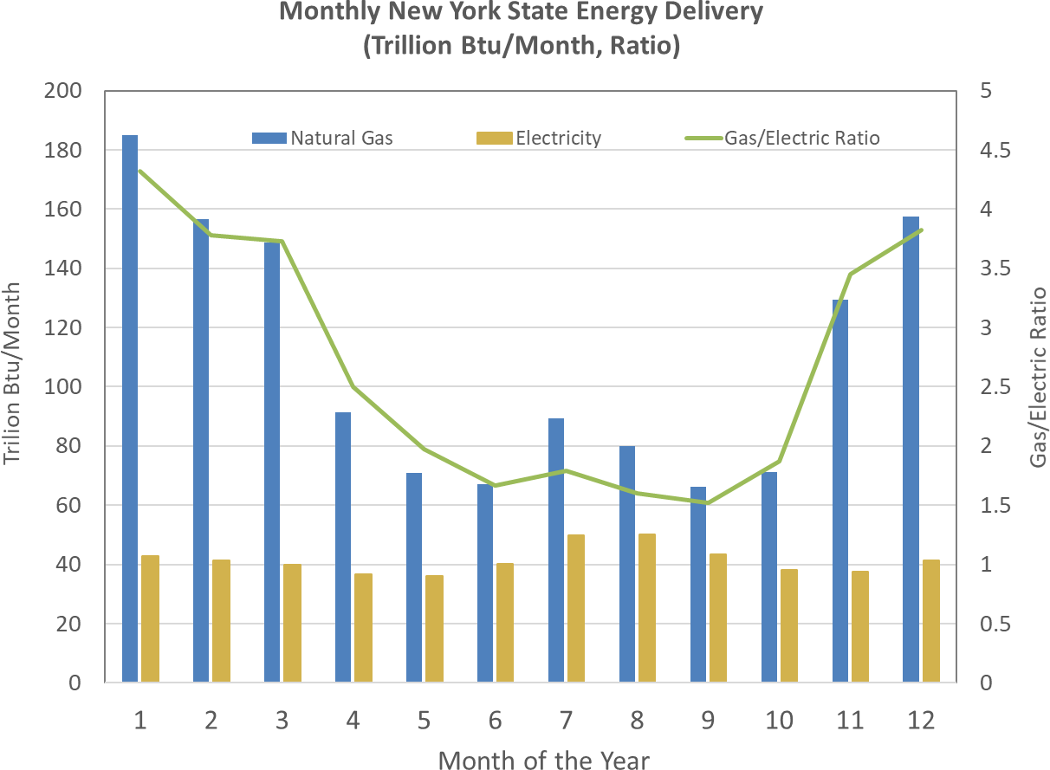

Utilize Existing Gas Networks
49,293
NY Gas Utility Miles
9,758
NFGDC NY Miles
Natural gas pipelines deliver over 4 times more energy than electric systems in a peak month.
11

Slide 12

What We Will Say About the Draft Scoping Plan
YES
To lower emissions and a careful, consumer-focused energy transition
To expanded energy efficiency as STEP ONE
To a dual-heat pathway as essential in WNY climate
To gas appliance bans
To the use of low-carbon renewable natural gas and hydrogen for lowering emissions in heating
To the use of existing natural gas delivery system AND electric system for a reliable, resilient energy system
To decommissioning of the gas system
YES
YES
NO
YES
YES
NO
12

Slide 13
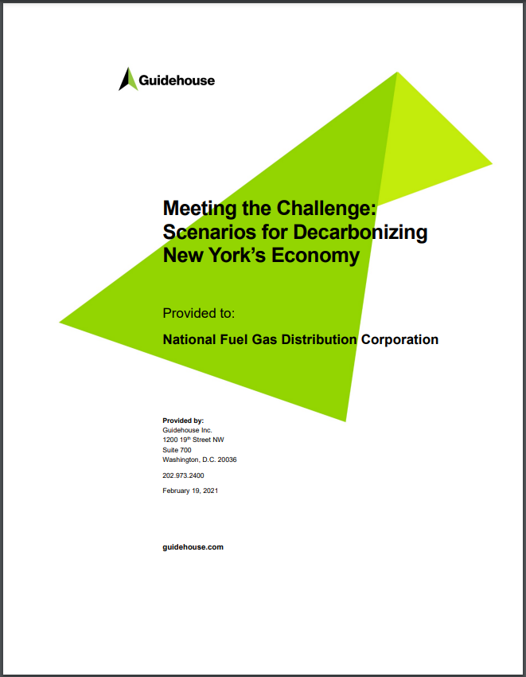
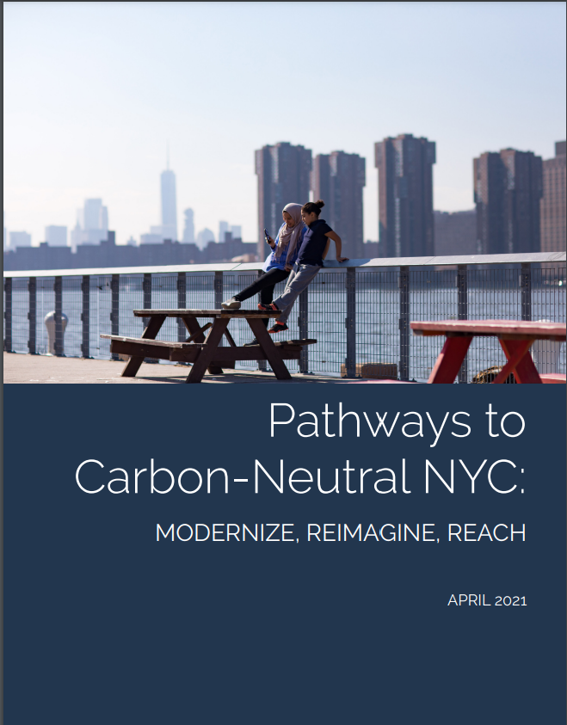
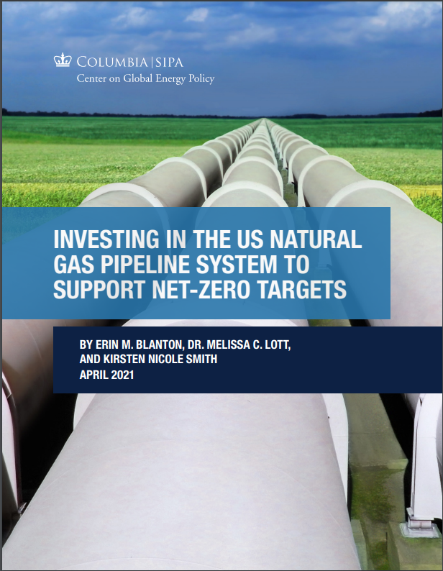
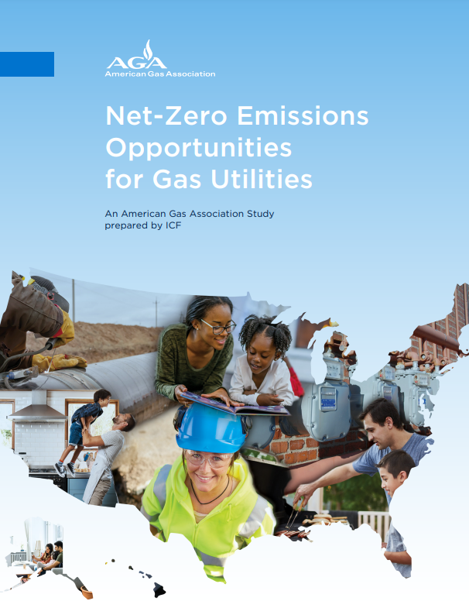
Recent Decarbonization Studies:
Consider a broad array of options…
February 2021
April 2021
April 2021
February 2022
Guidehouse Inc./National Fuel
NYC Mayor’s Office of Sustainability
ConEd/National Grid
Columbia University’s Center on Global Energy Policy
American Gas Association
13

Slide 14
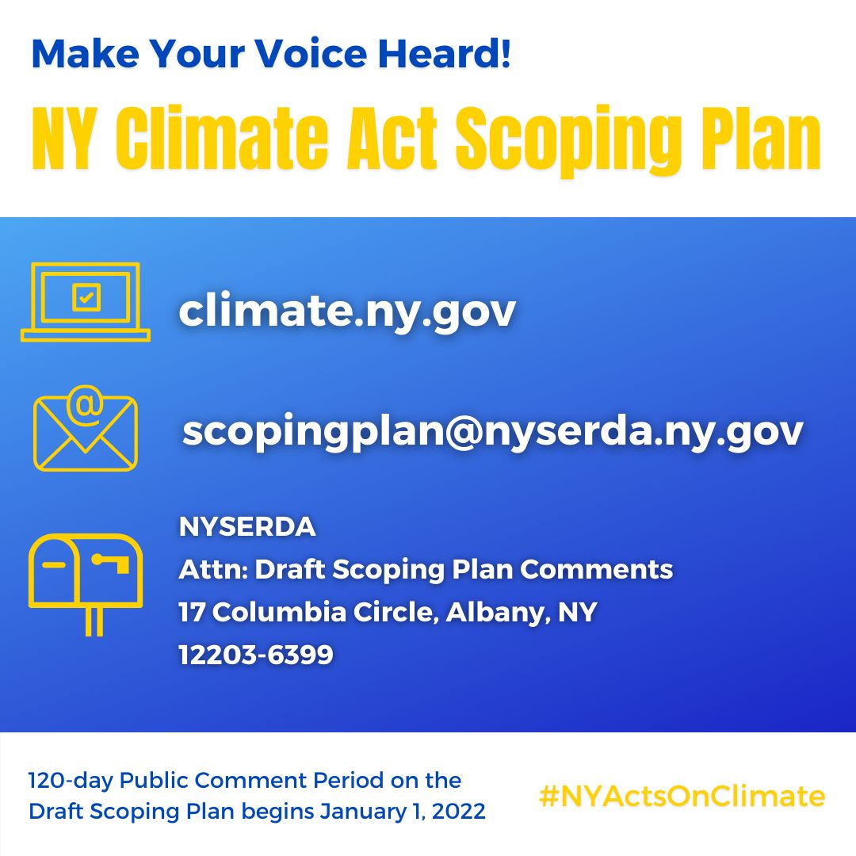
14

