Slide 1
NY CLCPA Implementation: Critical Issues Briefing
Status, Costs, and Critical Issues
Roger Caiazza, Pragmatic Environmentalist of New York
NYpragmaticenvironmentalist@gmail.com
February 2026

Slide 2
Urgent Climate Act Issues
How will DEC address the NYCI litigation?
When will DEC propose NYCI regulations and what will they propose?
Will the PSC hold a hearing on the PSL-66 P safety valve?
Will Hochul propose amending the Climate Act schedules?
Will NYSERDA provide all the Climate Act costs?
What if Hochul proposes revising the Climate Act GHG emissions accounting?

Slide 3
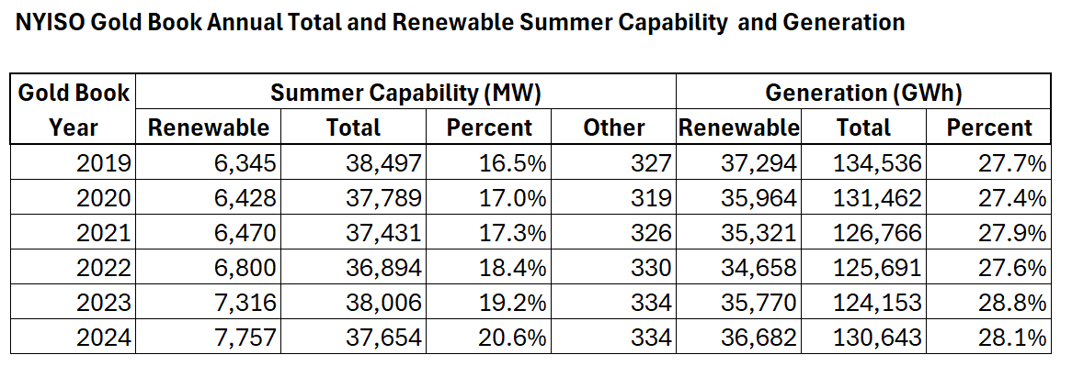
Target Trajectory vs. Reality
70% renewable electricity by 2030 goal - No appreciable change in the percentage of renewable electricity generation
40% GHG emission reduction by 2030 mandate - Economy‑wide emissions reductions through 2023 are only 14% less than 1990

Slide 4
Statutory Compliance & Litigation Risk
Missed statutory NYCI deadlines and court-ordered catch‑up
  Jan 1, 2024: DEC regulations deadline MISSED
  Oct 2025: Court ruling – State violated Climate Act
  November: DEC appealed but in January appealed was rejected
  Feb 6, 2026: Court-ordered regulatory deadline TODAY
Most of the other schedules are late and unlikely to hit goals
  Inevitable litigation

Slide 5
Affordability Rate Case Impacts
Recent approved electric rate cases range between 10% and 31% over three years
DPS Informational Report claims residential impacts of the Climate Act range from 4.6% to 10.3% of 2023 total monthly electric bills
The number of customers in arrears greater than 60 days increased by 33% between 2019 the last year before the CLCPA was implemented and 2024

Slide 6
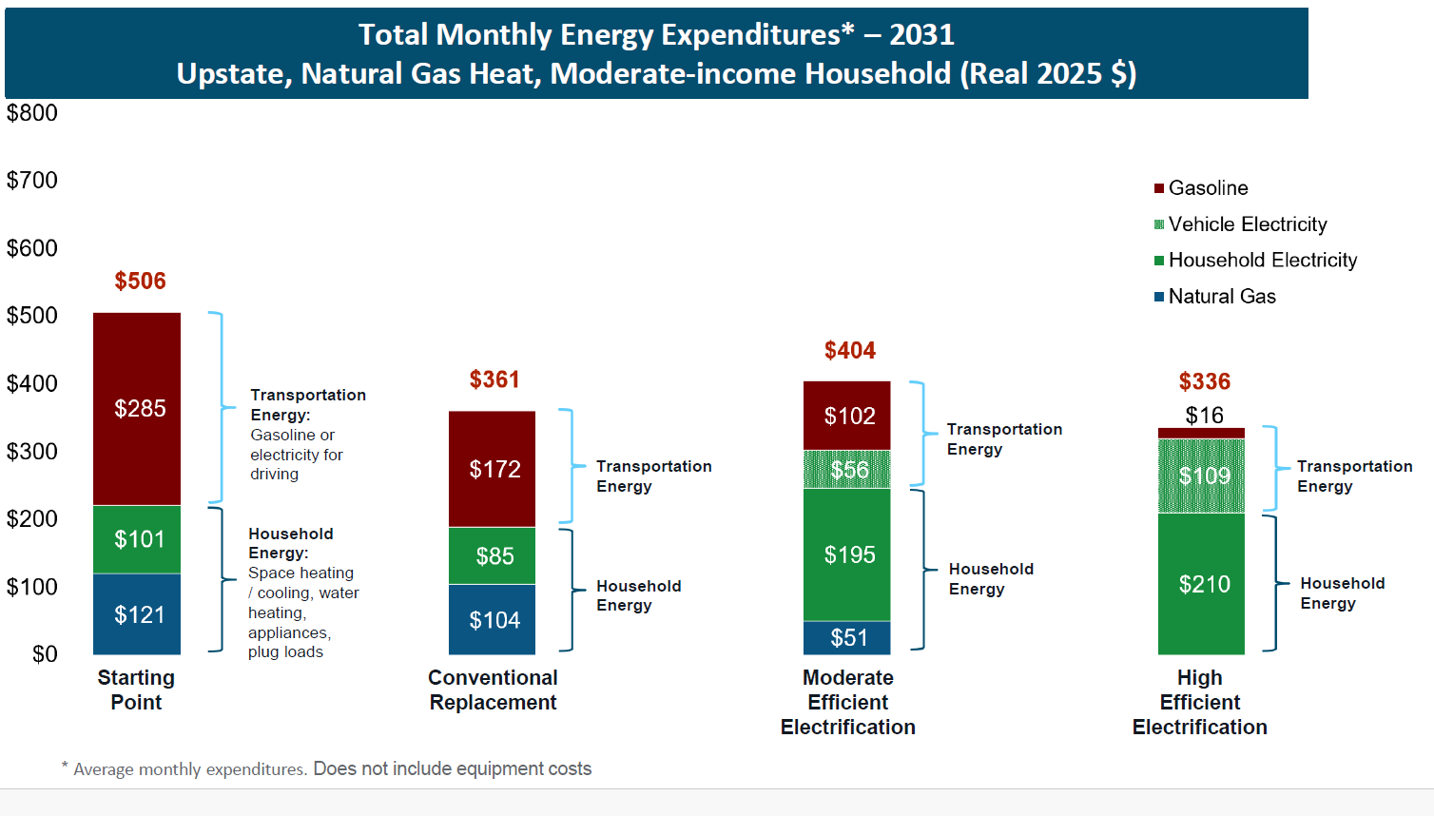
State Energy Plan (SEP) Cost Estimate

Slide 7
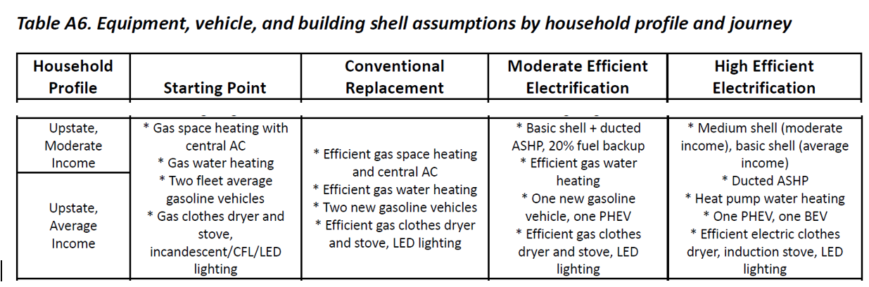
Table A-6 SEP Impacts Assessment

Slide 8
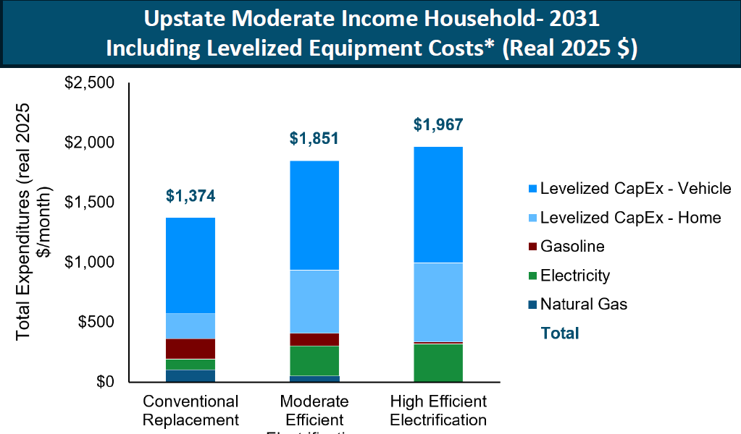
SEP Cost Including Equipment Cost

Slide 9
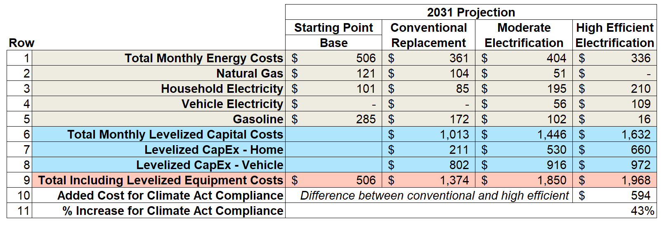
SEP Costs Including Equipment Costs
Upstate New York moderate income household that uses natural gas for heat projected monthly costs and hardware costs necessary to comply with the Climate Act

Slide 10
PSL 66-P Safety Valve
Public Service Law 66-P “renewable energy systems” includes a provision for the PSC to conduct a hearing “if the program impedes the provision of safe and adequate electric service” or if “there is a significant increase in arrears”
Filings by the Coalition for Safe and Reliable Energy and the Independent Intervenors called for a hearing
On 1/28/26 the PSC requested comments on the Coalition request for a hearing
Comments are not due until 3/30/26

Slide 11
Reliability and Resource Adequacy
NYISO analyses have raised significant concerns
  Tightening reliability margins and resource adequacy.
  Coordination of fossil retirements with new resources
  Dependence on a few critical transmission projects
  Operational challenges from high levels of intermittent renewables
  Need for “firm, zero‑emissions” and long‑duration solutions (technology gap)

Slide 12
Renewable Build‑Out, Siting, and Transmission
Offshore wind program 9,000 MW offshore wind by 2035, Current 132 MW, Under Construction 1,734 MW, and Contracted 1,872MW
Land-based renewable delays due to project attrition due to interconnection costs, supply chain inflation, local opposition
Transmission
  The backbone is stronger but not finished.
  Bottlenecks are shifting, not disappearing
  Transmission is not yet fully synchronized with Climate Act contracts.

Slide 13
Renewable Buildout Issues
Renewable build-out under the CLCPA faces significant tension between state-level streamlining goals and local opposition.
The Section 94-c/RAPID Act framework enables preemption of local laws and creates uniform permitting through ORES, but permits still average 3.7 years despite statutory deadlines.
Local opposition has increased 32% year-over-year, with 46 restrictive local laws in New York and 108 BESS moratoria/bans statewide.
While host community agreements provide financial benefits to municipalities, they address developer and municipal interests rather than resident concerns about farmland loss, property values, and rural equity

Slide 14
Economy-Wide Cap‑and‑Invest Program
Status of New York Cap-and-Invest (NYCI)
  Mandatory GHG Emissions Reporting Rule - Finalized December 1, 2025
  Cap-and-Invest Rule - Not yet proposed the affected sources, binding caps or allowance allocations
  Auction Rule - Not yet proposed rules
Reporting Rule
  Poorly written – industry with most experience has many questions
  Requires emissions reporting rather than activity facto e.g., fuel use
Design trade‑offs to be resolved
  Price trajectory – design limits range of possible costs but what is it?
  Increase prices due to rule risks leakage (buy gas out of state)
  35 to 40% of revenues are supposed to benefit disadvantaged communities but how will this work (direct rebates vs. program spending).

Slide 15
GHG Emission Accounting
The governor said Monday that she is specifically interested in reconsidering the methodology by which the state tallies its emissions, explaining that New York’s unique 20-year metric puts the state at a disadvantage over other states that use a 100-year methodology to count their emissions.
Climate Act has unique emissions accounting requirements that elevate the importance of methane to Climate Act compliance. In particular, the Climate Act specifies that the global warming potential (GWP) must be calculated over a 20-year time horizon.
Climate Act authors argued that it was necessary for the Climate Act to use 20-year global warming potential (GWP) values because methane emissions would be ~ 3 times greater
This irrational obsession with methane is misguided because it is based on selective choice of the science and ignores inconvenient aspects of radiation physics which indicate that laboratory measurements of global warming potential do not translate to the atmosphere where it counts.
In the Budget Season 2023 this change in methodology was proposed because it would reduce the total GHG emissions. When NYCI kicks in that will translate to lower costs to New Yorkers

Slide 16
Sector‑Specific Implementation Gaps
Buildings
  Pace of building electrification and heat pump deployment is inconsistent with Climate Act mandates
Transportation
  EV adoption trajectory is inconsistent with Climate Act targets
Industry and “hard‑to‑abate” sectors
  Technological issues associated with emission reductions are unresolved
Agriculture and land use
  Net-zero targets require sequestration in plants and soils

Slide 17
Near-Term Issues
How will DEC address the NYCI litigation?
When will DEC propose NYCI regulations and what will they propose?
Will the PSC hold a hearing on the PSL-66 P safety valve?
Will Hochul propose revising the Climate Act GHG emissions accounting?

Slide 18
Strategic Choices for the Future
Will the reality of the magnitude of the problems create support for revisions to the Climate Act.
Amend the CLCPA timelines and mandates vs. attempt to force compliance on current dates.
Embrace a “clean firm” strategy (nuclear) vs. continued emphasis on wind/solar plus batteries has impacts on schedule
Building and transport electrification infrastructure and affordability problems

