Slide 1
Independent Intervenors NYPA Conferral Process Presentation
Reliability-first implementation of New York’s
clean-energy transition
September 2, 2026
Roger Caiazza Morris Cox
Richard Ellenbogen Francis Menton
Constantine Kontogiannis

Slide 2
Why We Are Here
Grid reliability is rapidly decreasing due to the lack of dispatchable generation and increased electrification loads, which is a direct result of CLCPA policy and its lack of technical merit.
Zero-carbon electricity mandates (70% by 2030 and 100% x 2040) were not adjusted by recent budget legislation and remain in full effect.
The recent push for nuclear generation only addresses base load requirements with earliest new asset availability 15 - 20 years away.
Roughly half of our current dispatchable natural gas generation is beyond its useful life but cannot be retired due to shrinking reserve margins.
DEFRs cannot keep the grid operating during worst case dark doldrums, heat domes, and smoke haze conditions without massive, unaffordable oversizing.

Slide 3
The Grid is Already Broken
Multiple upstate distribution-level failures in June 2025 occurred when the loss of NYCA reserve margin led to voltage reductions on substations already overloaded by increased building and vehicle electrification.
Despite full deployment of SCR/EDRP resources, downstate frequency instability and voltage reductions in July 2026 led to significant property damage and personal injury, including a massive sewage spill, dozens of elevator rescues, and widespread permanent damage to electronics.
The brownouts of today result in different failure modes than 20 years ago due to the growth of constant power electrical equipment such as variable frequency drives, LED lighting, and SCR elevator equipment.
Generator transfer switches and solar/wind / battery inverters cannot function properly in brownout conditions, resulting in the loss of essential grid support.
Combined with higher system loading and heat stress, minor storm damage more often results in power outages extending beyond a single substation.

Slide 4
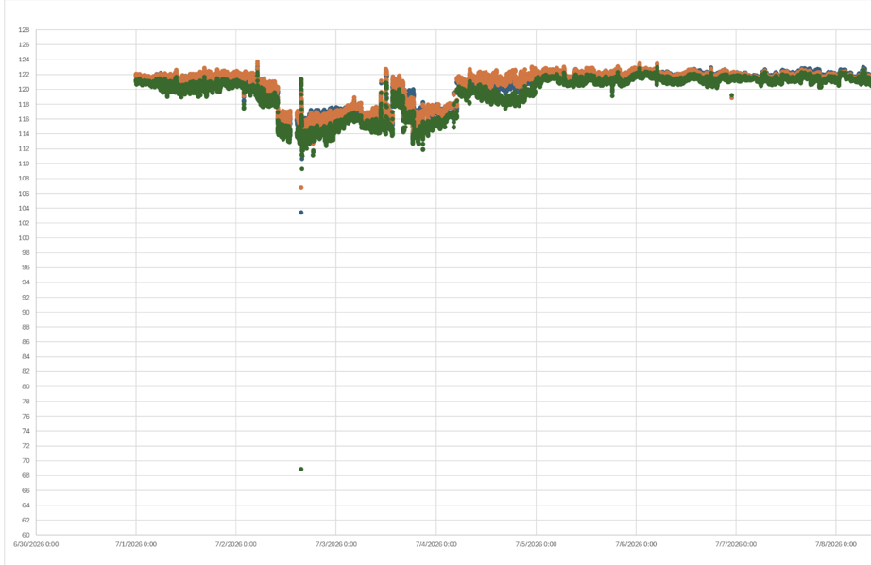
The Grid is Already Broken
July 1 – July 7, 2026 Con Edison Voltage Instability

Slide 5
Two Systems Must be Considered
Bulk-power-system reliability: NYISO resource adequacy, transmission security, reserves, imports, fuel availability, and system operations.
Distribution-system resilience: utility voltage quality, local outages, inverter performance, critical facilities, and restoration.
Recent reliability shortfalls, brownouts, and full outages need to be understood without conflating NYISO’s upstate/downstate terminology with transmission-versus-distribution responsibilities.
NYPA must coordinate with NYISO, PSC, utilities, and state/local governments, but should clearly identify which entity is accountable for each reliability issue.

Slide 6
CLCPA Mandates are Unachievable
Without 10+ GW of yet-to-be identified DEFRs coming online in less than 5 years, the only way to avoid blackouts is the continued reliance on older, inefficient gas and dual-fuel powerplants.
There has never been a detailed feasibility study for the CLCPA generation mandates from a reliability, affordability, and/or sustainability standpoint.
There are no large-scale examples of this aspirational mix of clean energy generation assets in existence anywhere in the world today.
NYISO clearly states in their Power Trends and System & Resource Outlook publications that the repowering of existing natural gas and dual-fuel powerplants is crucial to maintain grid reliability.
Absent any “silver bullet” DEFR solutions, NYPA must adopt NYISO reliability concerns and push back on the 2030 and 2040 CLCPA generation mandates.

Slide 7
PV, Wind, and BESS Cannot Fill the Need
July 1, 2026 example of wind generation less than one percent of nameplate capacity.
Repeated Summer 2025 and 2026 PV generation shortfalls due to smoke haze conditions.
January 2026 “dark doldrum” conditions led to critical grid risk and historic consumer energy cost spike.
Worst-case dark doldrum system planning must anticipate 110+ continuous hours of less than 25% combined PV/wind nameplate capacity.
BESS could only accommodate the worst-case 70 x 30 dark doldrum scenario with a trillion-plus dollar investment.

Slide 8
A Practical CLCPA Scorecard
Required outcome | Question that must be answered
Reliable service | Can the system meet demand during multi-day heat, low wind, forced outages, and constrained imports?
Affordable service | What is the all-in cost to customers, including generation, transmission, distribution, interconnection, storage, backup, and curtailment?
Feasible construction | Can projects be financed, permitted, sited, connected, and completed on the assumed schedule?
Environmental performance | What are the actual emissions benefits, including the effect of imports, backup generation, and dispatch changes?
Community legitimacy | Have host communities had meaningful input before projects and transmission routes are effectively predetermined?

Slide 9
The Nuclear Push is Long Overdue
New large-scale nuclear generation offers a proven, long-term solution to overall load growth, but the proposed 5 GW capacity increase will barely cover other asset retirements over the same timeframe.
Traditional nuclear power generators should not be represented as DEFR solutions, but rather as economically viable base load assets.
An explicit acknowledgement of the prolonged design and construction schedule for these assets is needed to dispel undue expectations.
SMR and MMR technologies warrant further study and pilot testing but must not be recognized as a near future DEFR solution due to current TRL status.
In order to meet the expectation of nuclear EPCs and funding sources, NYPA must adopt to industry procurement standards with enhanced responsiveness.

Slide 10
CCGT Needed to Close DEFR Gap
CCGT repowering sites in Newburgh, Island Park, Northport, Port Jefferson, and along the East River provide the greatest reliability benefits.
Upstate new-build CCGT opportunities should be explored in concert with agricultural CO2 sequestration and/or waste-to-energy solutions that address alternative pathways to sustainability.
Hydrogen technology has sufficiently matured to offer a low-emission CCGT standby fuel alternative to #2 oil - potentially in Newburgh, Island Park, or new upstate locations.
NYPA’s public authority, financing capacity, and permitting experience can enable investments that private developers will not make under current market and policy uncertainties.
NYPA must quantify grid reliability, economics, and lifecycle sustainability to justify new and repowered CCGT projects.

Slide 11
Additional NYPA Project Involvement
Floating PV generation at the Schoharie and Upper Blenheim-Gilboa reservoirs is a cost-effective seasonal capacity booster to the existing NYPA pumped storage asset, and significantly enhances black start system capability as well.
Central East transmission interface to CHPE at New Scotland reduces reliance on diminishing HQ imports and offers a more direct pathway for otherwise curtailed wind generation from Zones A, B, C and E.
Construction of new transmission along the NYS Thruway from Leeds to Dunwoodie provides critical linkage with less community pushback.
Development of untapped hydroelectric potential at multiple major reservoir sites offers a long-term clean energy solution.

Slide 12
Closing Points
Dependable generation must be provided until replacement resources, transmission, fuel arrangements, and operating reserves are physically available, deliverable to load, and proven under stressed conditions.
NYPA’s role should be to close—not widen—the gap between public-policy objectives and NYISO-identified reliability needs.
NYPA should focus on grid projects that reinforce reliability, and push back on unsupportable mandates.

